Slide 1
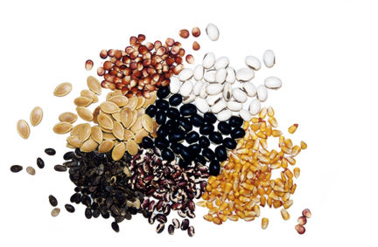
Plants
By Nikki Pagano
Illustrated by Drew-Brook Cormack

Slide 2
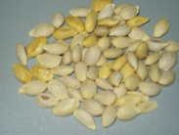
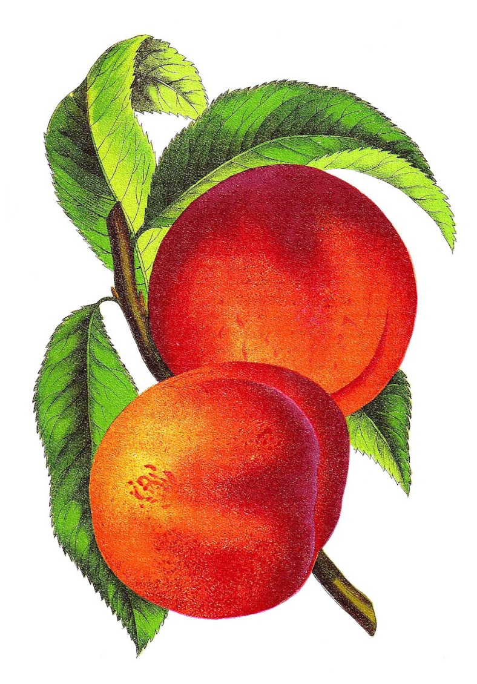
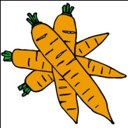
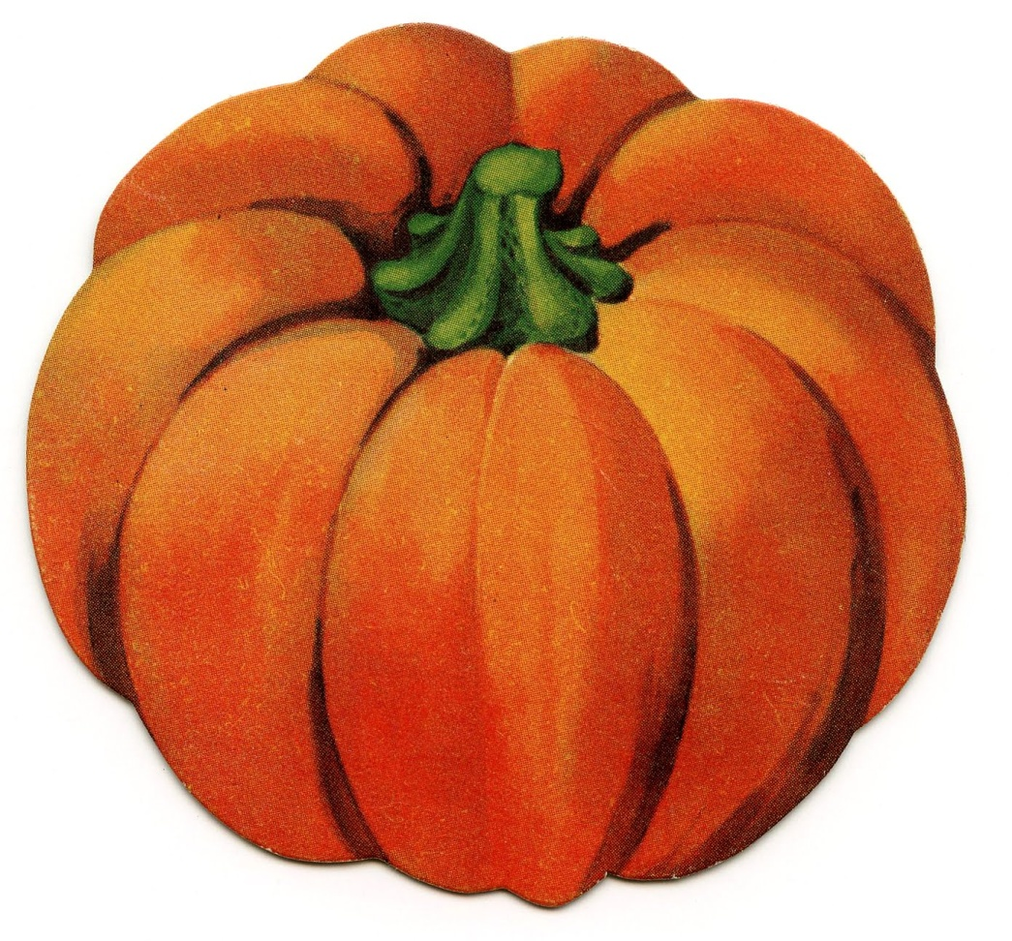
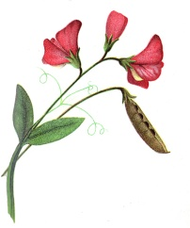
About the Story
What is in the story?
seeds
peach
leaves
carrot
watermelon
pumpkin
flower
What is in the story about?
The story is about all kinds of plants.

Slide 3
Seeds make plants. A seed needs a lot of rain and a lot of sun before it can grow big and strong.

Slide 4
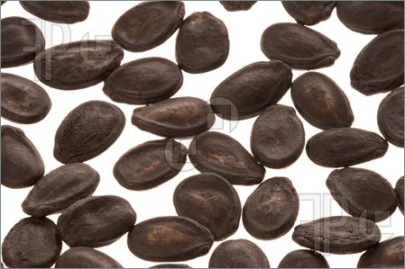
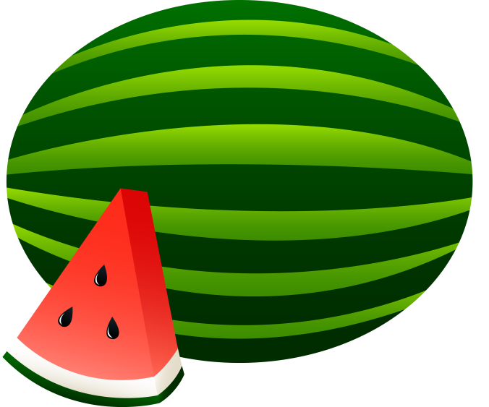
You may plant this black seed in wet dirt. After about six days, vines will pop out. A blossom may bloom and then watermelon may grow.
A watermelon is red and green. If you wait, it will big and sweet. Yum! Yum! Yum!

Slide 5
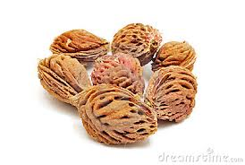
This seed is named a pit or a stone. It may grow to be a peach. It will need a lot of water and sun to help it grow.

Slide 6
A peach grows on a tree. Can you see big, green leaves on this peach tree? Pick a peach off a tree. A peach is a sweet treat that tastes as fine as it can. Yum! Yum! Yum!

Slide 7
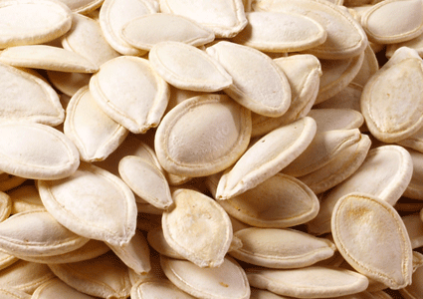
Do you see the thin seeds? You may add water and sun to these seeds. A big orange pumpkin will grow and lay on soft ground.

Slide 8
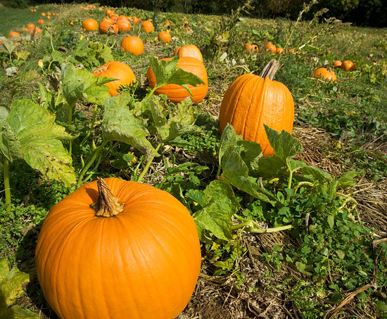

Slide 9
Pumpkins have thin lines and thick stems. Pumpkins have seed inside. You may make pumpkins into a pie. Mmmmm. Yum! Yum! Yum! Yum!

